Slide 1
Building Scalable, Cloud-Ready Applications with RESTier
Chris Woodruff
Quicken Loans
Platform Strategist
chriswoodruff@quickenloans.com

Slide 2



Slide 3

Remote Procedure Call (RPC)
types of
web
services

Slide 4

Remote Procedure Call (RPC)
Simple Object Access protocol (SOAP)
types of
web
services

Slide 5

Remote Procedure Call (RPC)
Simple Object Access protocol (SOAP)
types of
web
services
Calls over HTTP

Slide 6

Remote Procedure Call (RPC)
Simple Object Access protocol (SOAP)
types of
web
services
Calls over HTTP
Representational State Transfer (REST)

Slide 7
evolution of services

Slide 8

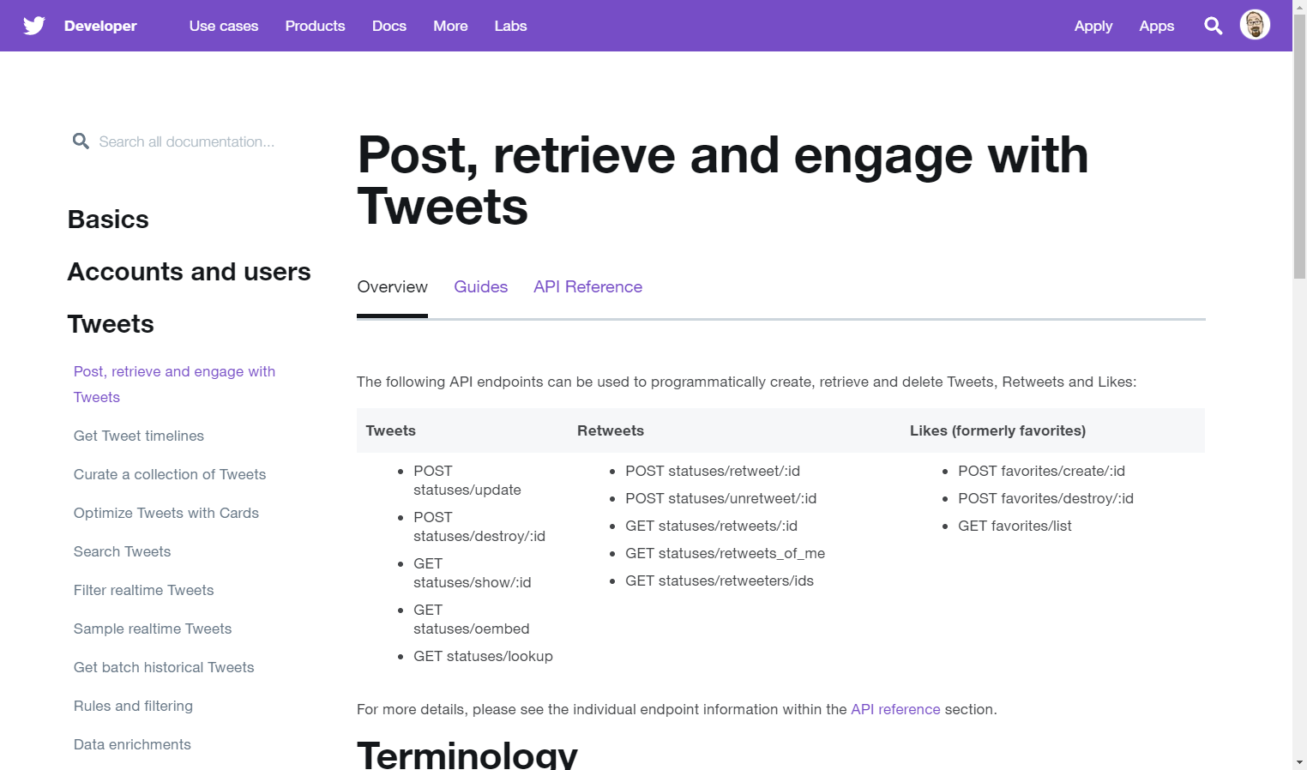

Slide 9

the power of
$metadata

Slide 10
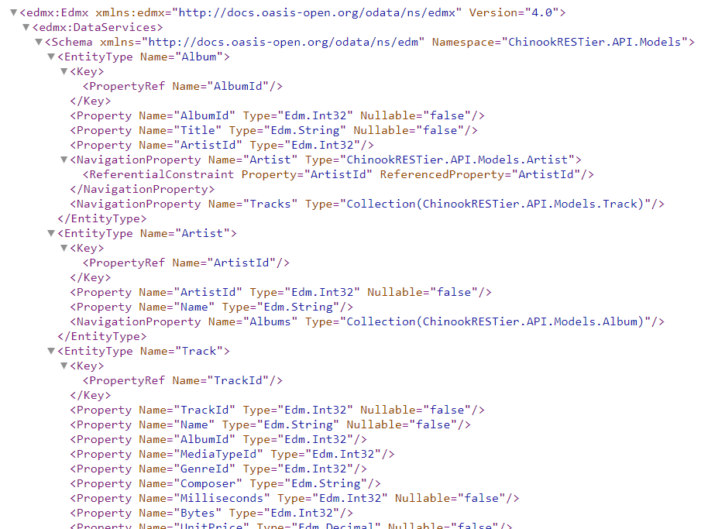

Slide 11

Chris Woodruff
Platform Strategist

Slide 12
OBSESSED WITH FINDING A BETTER WAY.
Quicken Loans ISMs

Slide 13

agenda
producing

Slide 14
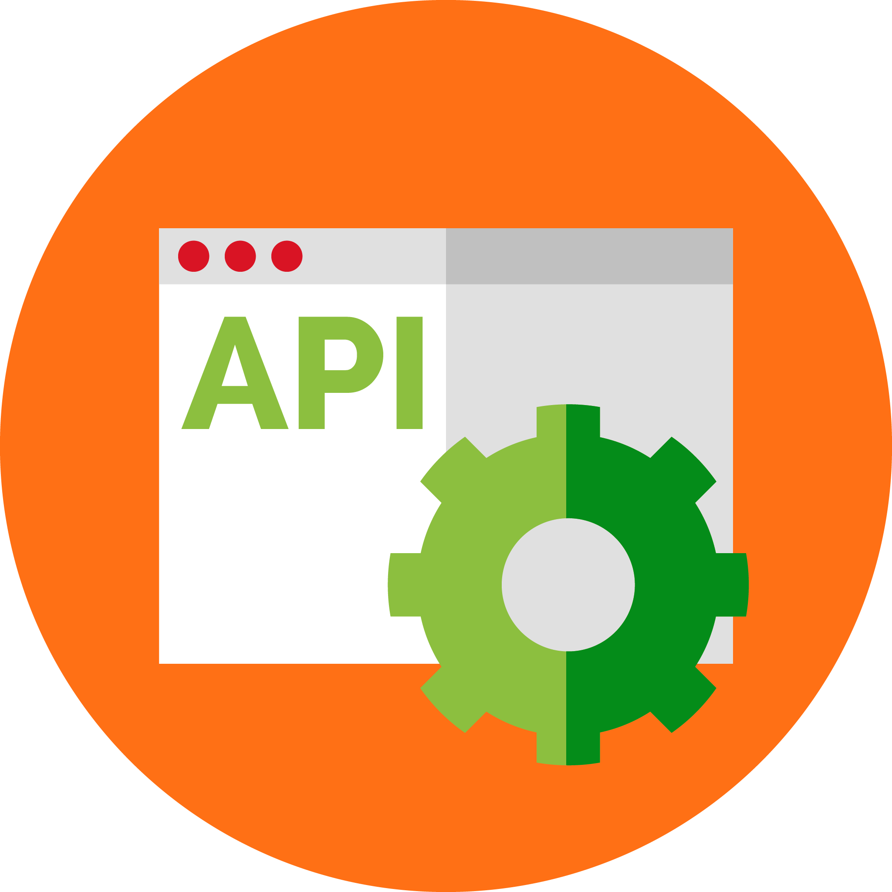
agenda
producing
consuming

Slide 15

agenda
producing
consuming
testing

Slide 16
OData
Open Data Protocol

Slide 17
producing the
RESTier Web API

Slide 18
demo

Slide 19
consuming a
RESTier Web API

Slide 20

generate the
RESTier Client

Slide 21
demo

Slide 22
testing a
RESTier Web API

Slide 23
demo

Slide 24

the bliss from using
RESTier

Slide 25
help the
RESTier Project
https://github.com/OData/RESTier

Slide 26

Thank you!
Chris Woodruff
Quicken Loans
Platform Strategist
chriswoodruff@quickenloans.com
@cwoodruff

